Slide 1
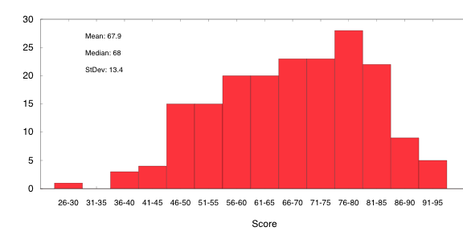
6.033 Lecture 10 Layering and Reliability
slides: http://mit.edu/6.033/www/assignments/lec10.pdf
Key Ideas:
3 Layer Network
At least once delivery
At most once delivery
Sliding window protocol
March 8, 2010
Quiz 1 Scores

Slide 2
End-to-end Interface
Src
conn=open_stream(dest,port)
send(conn,bytes1)
send(conn,bytes2)
close_stream(conn)
Dest
conn= listen(port)
bytes=recv(conn)

Slide 3
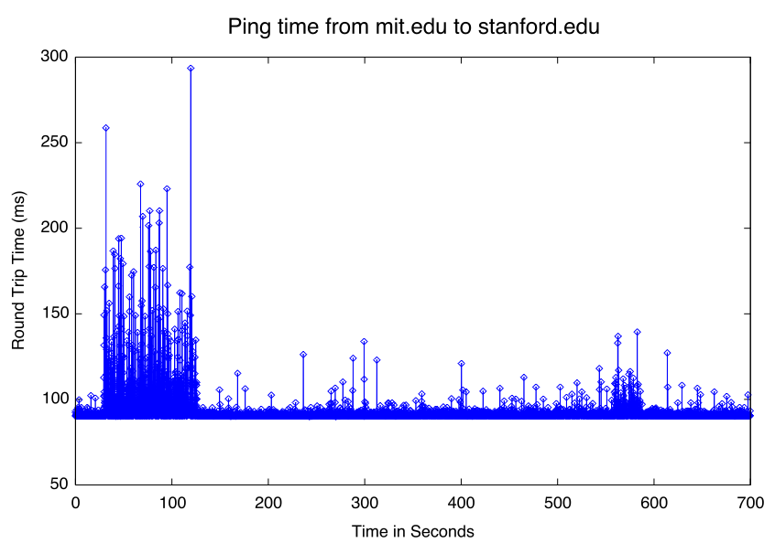
RTT Is Variable

Slide 4
Exponentially Weighted Moving Average (EWMA)
measure = new RTT measurement
rtt = α(measure) + (1-α)(rtt) ; α = 1/8
timeout = β * rtt ; β = 2

Slide 5
Sliding Window in Action
window = 1-5
window = 2-6
1
2
3
4
5
6
Sndr
a1
a2
Rcvr
p1
p2

Slide 6
Sliding Window in Action
window = 2-6
window = 3-7
1
2
3
4
5
6
7
Sndr
a1
a2
a3
Rcvr
p1
p2
p3
Send next packet as acks arrive, rather than waiting for all acks in window

Slide 7
Still may wait
window = 1-2
window = 2-3
window = 3-4
1
2
3
4
5
6
7
idle
idle
idle
Sndr
a1
a2
a3
a4
a5
Rcvr
p1
p2
p3
p4
p5

